Slide 1
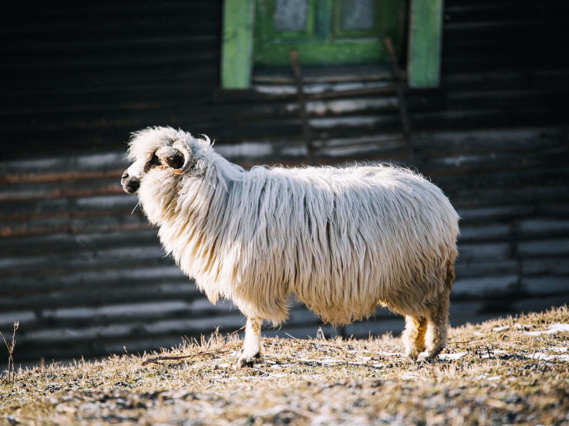
Animal Farm
DR. NIRMALA S. PADMAVAT
BA FY NOTES

Slide 2
Introduction
The writer of "Animal Farm" is the celebrated English author George Orwell. Born as Eric Arthur Blair on June 25, 1903, in Motihari, India, Orwell is widely regarded as one of the most influential and important writers of the 20th century. He adopted the pen name George Orwell to avoid embarrassing his family while pursuing a literary career.
Orwell's writing style is characterized by its clarity, simplicity, and political consciousness. He was deeply committed to social justice and used his works to critique political ideologies and totalitarian regimes. Orwell's experiences as a British colonial officer in Burma, as well as his time living among the working class in England, profoundly influenced his writing.
Some of his most renowned works include "Animal Farm" (1945), a satirical allegory that critiques the rise of totalitarianism using farm animals as characters, and "1984" (1949), a dystopian novel that explores the dangers of an oppressive surveillance state.

Slide 3
Introduction
Orwell's writings often tackle themes such as the abuse of power, the importance of truth and language, the dangers of propaganda, and the struggle for individual freedom. His ability to weave powerful and thought-provoking narratives made him a significant voice in the literary world.
Sadly, George Orwell's life was cut short by tuberculosis, and he passed away on January 21, 1950, at the age of 46. Despite his relatively short life, his literary contributions have left a lasting impact on literature and continue to be widely read and studied to this day. Orwell's insightful and prophetic writings have solidified his position as an enduring and influential figure in the world of literature and social commentary.

Slide 4
Plot
Animal Farm" is a satirical allegorical novella written by George Orwell, published in 1945. The story is an allegory for the Russian Revolution and the subsequent emergence of the Soviet Union under Joseph Stalin's rule. It critiques the dangers of totalitarianism, the abuse of power, and the manipulation of language and propaganda.
The plot of "Animal Farm" revolves around the animals of Manor Farm, who are fed up with the oppressive and neglectful rule of their human farmer, Mr. Jones. Led by the pigs, specifically Old Major, Snowball, and Napoleon, the animals stage a rebellion and successfully overthrow Mr. Jones. They rename the farm "Animal Farm" and establish a set of principles called the Seven Commandments, which promote equality and a society where all animals are free and equal.

Slide 5
Plot
Initially, the farm prospers under the leadership of Snowball and Napoleon. Snowball, an eloquent and charismatic pig, introduces various innovations and improvements for the welfare of the animals. He also proposes the construction of a windmill to generate electricity for the farm, promising it will improve their lives.
However, as time passes, Snowball and Napoleon's ideals diverge. Snowball represents the more idealistic and visionary leader, while Napoleon is cunning, manipulative, and power-hungry. During a heated debate about the windmill, Napoleon summons a pack of dogs he has secretly raised to chase Snowball away, solidifying his control over the farm.

Slide 6
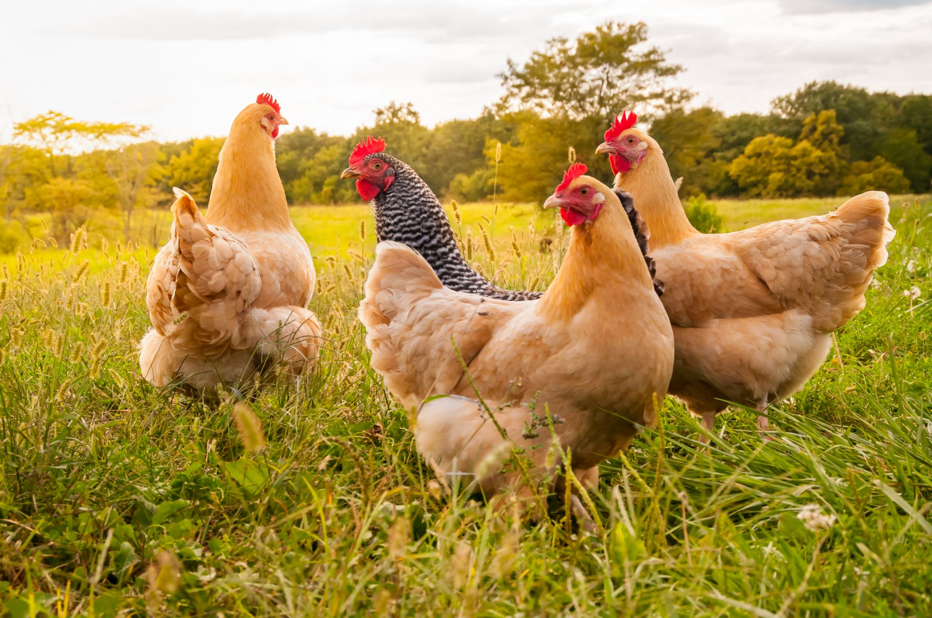
Plot
With Snowball gone, Napoleon consolidates power, and the Seven Commandments are gradually altered to suit the pigs' interests. The pigs start living in the farmhouse, wearing clothes, and adopting human-like behaviors, while the other animals toil hard and face increasing shortages.
The Commandments are further manipulated, and the pigs begin to enjoy privileges, such as eating special food and drinking alcohol. Meanwhile, Boxer, a devoted and strong horse, works tirelessly for the farm, blindly loyal to the pigs and their propaganda.
The animals continue to face hardships and oppressive conditions while the pigs, led by Napoleon, grow richer and more powerful. Napoleon also develops alliances with neighboring human farmers, betraying the original principles of the farm's revolution.
As time passes, the Commandments are entirely altered to a single maxim: "All animals are equal, but some animals are more equal than others." This phrase exposes the pigs' hypocrisy and the erosion of the farm's founding ideals.

Slide 7
Plot
In the end, the animals cannot differentiate between the pigs and the humans, as they see the pigs adopting human-like habits and values. The novella concludes with the animals witnessing the pigs socializing with humans and becoming indistinguishable from their former oppressors.
"Animal Farm" serves as a cautionary tale about the corruption of power and the dangers of totalitarianism. It illustrates how revolutions that start with noble intentions can devolve into oppressive regimes when leaders manipulate language, propaganda, and the fear of the masses to maintain control. The novella remains a powerful and enduring critique of political systems and a reminder of the need for vigilance in safeguarding freedom and equality.

Slide 8
Summary- Chapter 1:
"Animal Farm" begins on Manor Farm, a rundown farm owned by Mr. Jones. The farm animals, led by the wise and respected Old Major, a prize-winning boar, gather in the barn to hear him speak about a dream he had. He envisions a future where animals live free from human oppression. Old Major shares his teachings of "Animalism," a philosophy that promotes equality and freedom for all animals.

Slide 9
Chapter 2
After Old Major's death, the animals, inspired by his vision, stage a rebellion and overthrow Mr. Jones. They rename the farm "Animal Farm" and establish the Seven Commandments of Animalism, which include principles such as "All animals are equal" and "No animal shall kill any other animal."

Slide 10
Chapter 3
The pigs, who are more intelligent than the other animals, take charge of organizing the farm. Two pigs, Snowball and Napoleon, emerge as leaders. They teach the animals to read and write, and the farm becomes more productive. Snowball proposes building a windmill to generate electricity for the animals' comfort, but Napoleon opposes the idea.

Slide 11
Chapter 4
The animals work diligently, but food shortages arise. Napoleon secretly trains a group of dogs, intimidating the other animals into submission. One day, Snowball presents his windmill plans to the animals, and during a heated debate, Napoleon releases the dogs, who chase Snowball away, solidifying Napoleon's control over the farm.

Slide 12
Chapter 5
Under Napoleon's rule, Animal Farm faces new challenges and hardships. The pigs gradually take on human-like behaviors and privileges, while the other animals toil harder with less to eat. Napoleon forms an alliance with the neighboring farmers, Mr. Pilkington and Mr. Frederick, and sells timber to them.

Slide 13
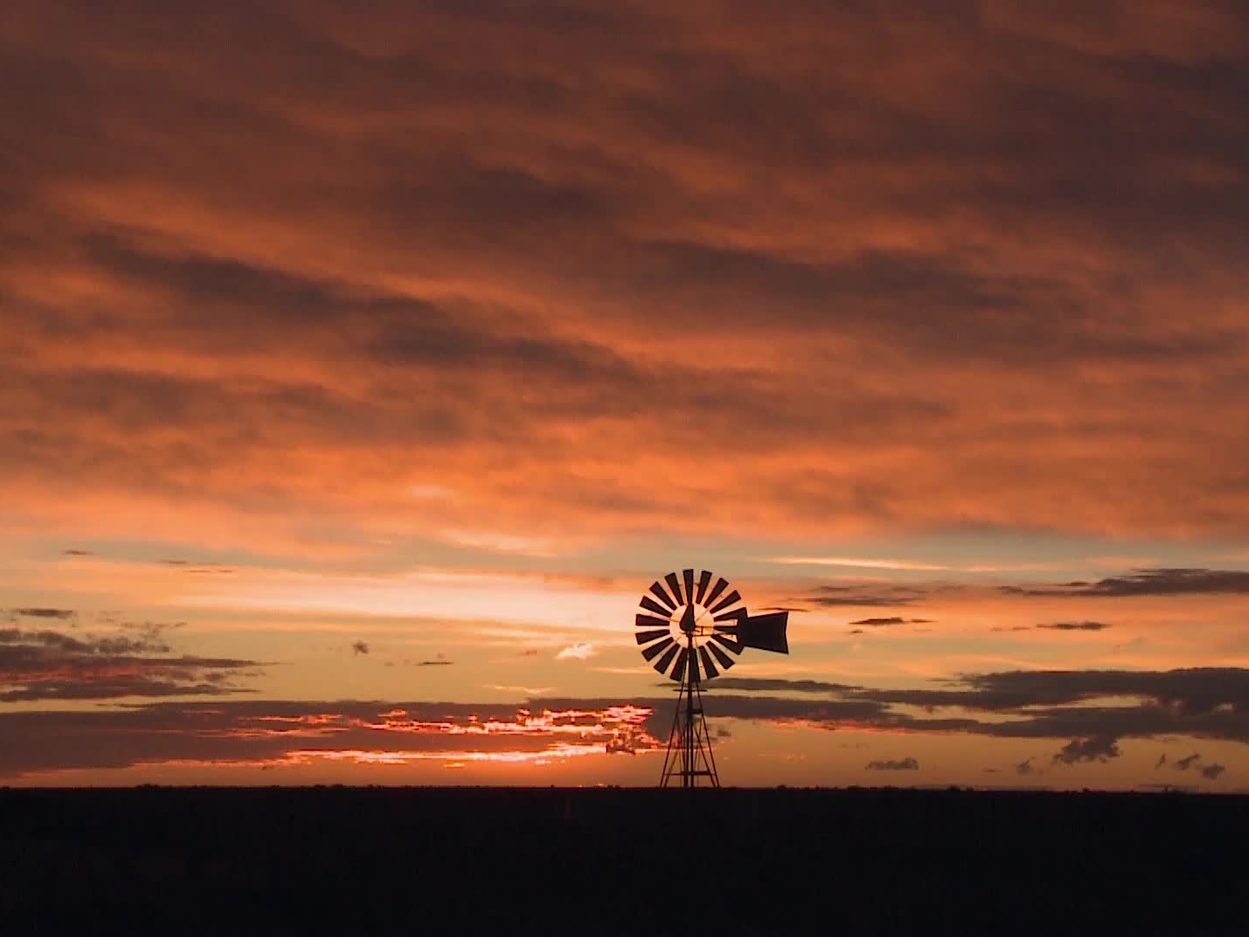
Chapter 6
The windmill construction begins, but it's a difficult and exhausting endeavor. Boxer, the hardworking and loyal horse, becomes the driving force behind the construction. The animals face multiple setbacks, and the windmill collapses due to a storm. Napoleon blames Snowball for the sabotage.

Slide 14
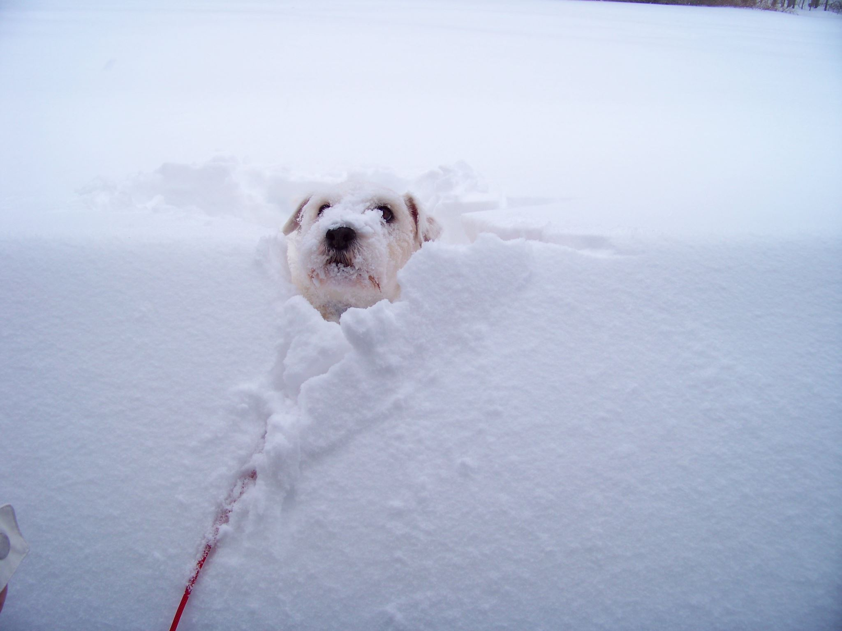
Chapter 7
Napoleon enacts a series of purges, accusing various animals of being in league with Snowball. They are executed by the dogs. The Commandments are altered to suit the pigs' desires. Squealer, the pigs' propagandist, convinces the other animals that these changes are for the greater good.

Slide 15
Chapter 8
As the farm faces increasing difficulties and hunger, Napoleon makes deals with humans, compromising the principles of Animalism. The animals work harder but receive fewer benefits. Boxer, now aging and weak, sustains an injury, and Napoleon sells him to the knacker for slaughter.

Slide 16
Chapter 9
The pigs, except for Squealer and Napoleon, are revealed to be living luxurious lives in the farmhouse. They entertain human guests and adopt human vices. Squealer manipulates the Commandments, and the animals can no longer differentiate between the pigs and humans.

Slide 17
Chapter 10
The pigs openly socialize with humans, symbolizing their complete transformation into oppressors. The original Seven Commandments are reduced to one phrase: "All animals are equal, but some animals are more equal than others." The animals' revolution has come full circle, and the dream of a free and equal society has been crushed.

Slide 18
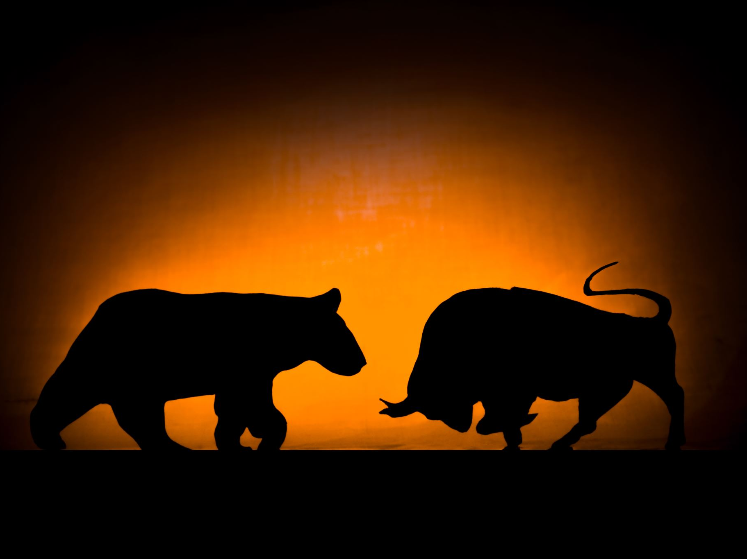
Characters
"Animal Farm" features a variety of characters, each representing different aspects of society and political ideologies. Here are the key characters in the novella:
Old Major: A wise and respected boar, Old Major is the visionary leader who inspires the animals with his dream of a future free from human oppression. He introduces the philosophy of Animalism and sets the stage for the rebellion against the humans.
Napoleon: A Berkshire boar, Napoleon is one of the main antagonists in the story. He becomes the leader of Animal Farm after driving out his rival, Snowball. Napoleon is cunning, manipulative, and power-hungry. He gradually consolidates control, turns the farm into a dictatorship, and transforms into a tyrannical leader.
Snowball: A white boar, Snowball is an intelligent and idealistic pig who becomes a prominent leader during the early days of Animal Farm. He plays a crucial role in planning the windmill and other improvements for the animals. However, he is chased away by Napoleon's dogs during a power struggle.

Slide 19
Characters
Boxer: A loyal and strong cart-horse, Boxer is one of the most dedicated and hardworking animals on the farm. He blindly supports Napoleon and the pigs, often repeating the mantra, "I will work harder." Despite his loyalty, Boxer is ultimately betrayed and sold to the knacker when he becomes injured and unable to work.
Squealer: A small, persuasive pig, Squealer is Napoleon's chief propagandist. He uses his eloquence and cunning to manipulate and justify the actions of the pigs, altering the Commandments and deceiving the other animals to maintain the pigs' control.
Benjamin: A cynical and wise donkey, Benjamin is one of the oldest animals on the farm. He is skeptical of the revolution and remains aloof throughout the novella. Despite his intelligence, he chooses not to act and becomes a passive observer of the unfolding events.
Mollie: A white mare, Mollie is a vain and materialistic animal who is more interested in her appearance and creature comforts than in the ideals of Animal Farm. She represents the privileged class who abandon the revolution for personal gain.

Slide 20
Characters
Mr. Jones: The negligent and irresponsible human farmer who originally owns Manor Farm. His mistreatment of the animals and failure to provide for them serves as a catalyst for the rebellion.
Mr. Frederick and Mr. Pilkington: The neighboring human farmers with whom Napoleon makes alliances. They represent the capitalist and imperialist powers that the pigs compromise with to further their interests.
The Dogs: A pack of fierce dogs raised by Napoleon to act as his enforcers and intimidate the other animals. They represent the secret police and the brutal force used by totalitarian regimes to maintain control.

Slide 21
These characters interact and evolve throughout the novella, reflecting the complexities of power, politics, and human behavior. Their roles and actions serve as allegorical representations of historical figures and political ideologies during the Russian Revolution and the rise of totalitarianism.

Slide 22
Seven Amendment in Animal Farm:
In George Orwell's "Animal Farm," the Seven Commandments of Animalism are initially established after the animals' rebellion against the humans. The Commandments represent the principles on which the farm is founded and are meant to promote equality and freedom among all animals. However, as the pigs gain more power, they gradually alter the Commandments to suit their own interests and consolidate their control. Here are the original Seven Commandments and how they evolve throughout the novella:
Original Seven Commandments:
Whatever goes upon two legs is an enemy.
Whatever goes upon four legs, or has wings, is a friend.
No animal shall wear clothes.
No animal shall sleep in a bed.
No animal shall drink alcohol.
No animal shall kill any other animal.
All animals are equal.

Slide 23
Evolution of the Commandments:
The first Commandment is altered to "No animal shall sleep in a bed with sheets," with the pigs justifying their use of beds by claiming it is for their health.
The second Commandment is modified to "No animal shall kill any other animal without cause," allowing the pigs to execute animals they deem traitors or enemies.
The third Commandment becomes "No animal shall drink alcohol to excess," permitting the pigs to indulge in alcohol while the other animals are prohibited from drinking.
The fourth Commandment is changed to "No animal shall kill any other animal without cause," giving the pigs the authority to execute animals they consider threats.
The fifth Commandment is altered to "No animal shall engage in trade," allowing the pigs to engage in business deals with humans.
The sixth Commandment is changed to "All animals are equal, but some animals are more equal than others," reflecting the pigs' complete transformation into human-like oppressors.
Throughout the novella, these modifications to the Commandments demonstrate how the pigs, led by Napoleon, manipulate language and propaganda to justify their actions and consolidate their power. The evolution of the Commandments is a clear allegory for the corruption of the original ideals of the Animal Farm revolution and the betrayal of the animals' initial hopes for equality and freedom.

Slide 24
Symbolism in Animal Farm
Animal Farm" is replete with symbolism, with various characters, events, and elements representing deeper political, social, and historical themes. Here are some of the key symbols in the novella:
The Farm: The entire setting of "Animal Farm" serves as a symbol. Initially called Manor Farm, it represents the oppressive and exploitative nature of the human society under Mr. Jones. After the animals' rebellion, it becomes "Animal Farm," symbolizing the hope and promise of a society where animals can govern themselves without human interference.
The Seven Commandments: The Seven Commandments of Animalism, which represent the principles on which the farm is founded, symbolize the utopian ideals of equality and freedom. Their gradual alteration and manipulation by the pigs symbolize the corruption of the revolution's original ideals.
Old Major's Dream: Old Major's dream of a world without human oppression and the anthem "Beasts of England" symbolize the initial inspiration and vision of the revolution. However, as time passes, the dream is manipulated and forgotten, representing the fading hopes of the animals for a better life.
The Pigs: The pigs, led by Napoleon and Snowball, symbolize the ruling class and the intelligentsia in society. They represent the Bolshevik leaders who initially led the Russian Revolution but ultimately became the new oppressive ruling elite.

Slide 25
Symbolism in Animal Farm
Napoleon: Napoleon, the power-hungry and ruthless pig, symbolizes Joseph Stalin, the Soviet dictator. His rise to power, purges, propaganda, and manipulation of the masses parallel Stalin's actions during his rule.
Snowball: Snowball symbolizes Leon Trotsky, one of the prominent leaders of the Russian Revolution who was eventually exiled by Stalin. Like Trotsky, Snowball is intelligent, idealistic, and focused on the greater good of the revolution.
Boxer: Boxer, the loyal and hardworking horse, symbolizes the uneducated working class. His devotion to the cause and eventual betrayal represent the way the working class is often used and exploited by political leaders.
Benjamin: Benjamin, the cynical and wise donkey, symbolizes the intellectuals and those who are aware of the hypocrisy and corruption but choose not to act. He represents the apathetic individuals who observe the events but do not take action against injustice.
The Windmill: The windmill symbolizes industrialization and progress. Initially intended to benefit all the animals, it becomes a symbol of the pigs' exploitation and manipulation of the other animals for their own gain.
The Dogs: The dogs, raised by Napoleon and used to intimidate and control the other animals, symbolize the secret police and the use of force and fear to suppress opposition and dissent.
Overall, "Animal Farm" is a powerful allegory that uses symbolism to critique political ideologies, totalitarianism, propaganda, and the abuse of power. The novella's rich symbolism contributes to its enduring relevance and impact on readers, offering a cautionary tale about the dangers of political corruption and the erosion of revolutionary ideals

Slide 26
Conclusion
"Animal Farm" is a powerful allegory that portrays the dangers of totalitarianism, propaganda, and the corruption of power. The novella serves as a critique of political systems and a warning against the erosion of principles in the face of authority. It remains a timeless and impactful work, reflecting George Orwell's concerns about totalitarian regimes and the manipulation of language and information.

Slide 27
Thank you!

